Slide 1
BRICK BREAKER GAME
BY GURRAM MONIKA

Slide 2
DESCRIPTION
A Brick Breaker game in java consists of Bricks aligned at the top of the screen.. It has a small ball that hits the Bricks with the help of a little platform at the bottom. The player uses this platform to bounce the ball towards Bricks. The more you break the Bricks, the more you score. If you miss the ball to bounce then game over.
TOOLS
JAVA SWING

Slide 3
FUNCTIONAL REQUIREMENTS
User , i.e, nothing but a Pladder
Ball
Bricks
IMPLEMENTATION
We used 3 classes in this project
1. Main class
2. Game play class
3. Map Generator class

Slide 4
MAIN CLASS
This the main class. In this I used main method. In this class I used Jframe . Jframe is used for creating outer window.
GAME PLAY CLASS
This is the Another Class. This Class is used for creating ball and slider and the moments of the ball and slider. If we click right arrow the slider moves right and if we click left arrow the slider moves towards left.
If we miss the ball the game will over and if we bounce the ball the score will increase and the bricks will decrease.

Slide 5
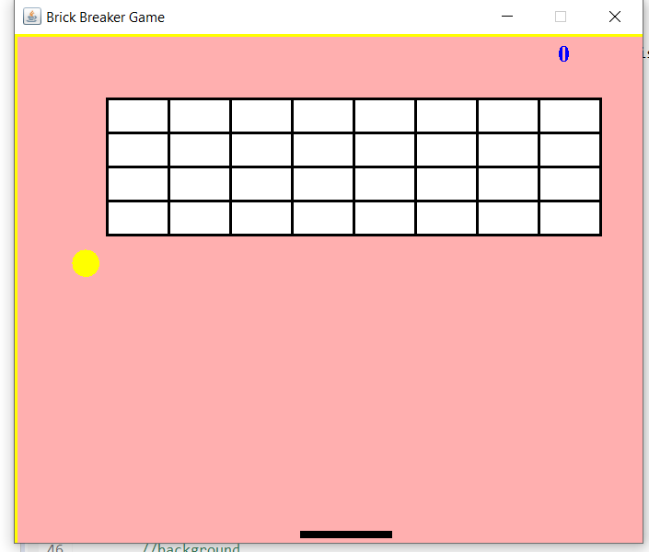
MAP GENERATOR
This is Another class . This class is used for creating Bricks. Firstly, we create one large Brick after that we divides into several parts as per width and height.
VISUALS
This is how our game looks like:

Slide 6
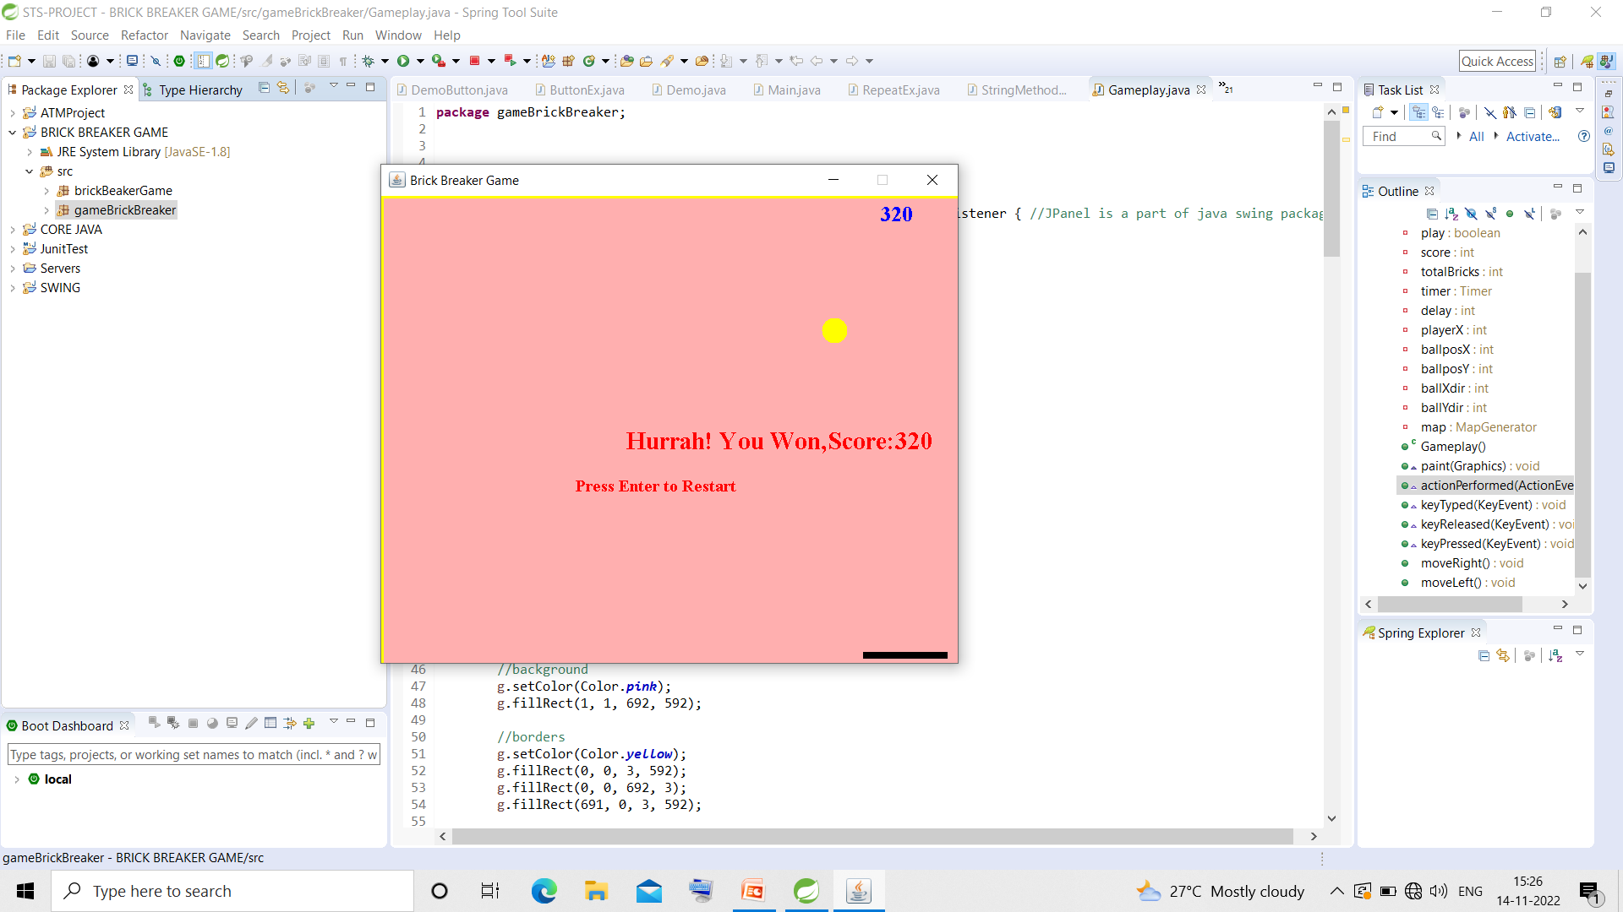
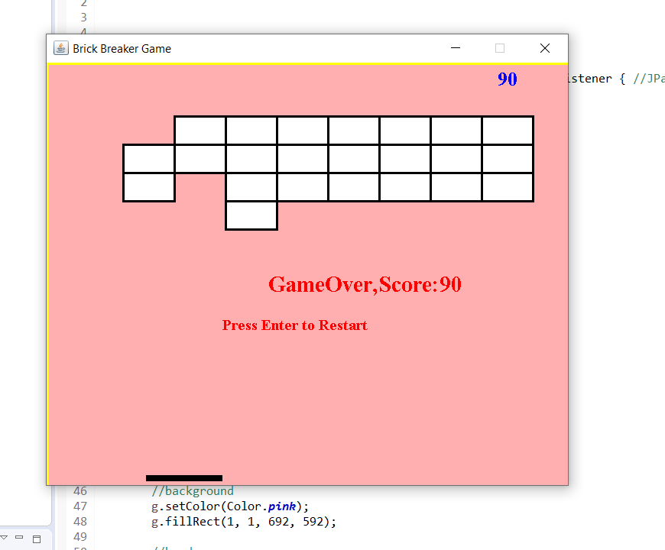
GAME WIN AND GAME OVER
This is how it looks This is how it looks after
after winning the game loosing the game

Slide 7
THANK YOU

Slide 8
CONCLUSION
This Game is working successfully. I like this project. I like this BRICK BREAKER game.

